Slide 1
Biosketches and Other Attachments
Presented by: Office of Research and Sponsored Programs (ORSP) and
Office of Sponsored Programs Administrative Network (OSPAN)

Slide 2
What is a Biosketch?
A biosketch highlights individual qualification for a specific role in a proposed project.

Slide 3
What Do I Include in a Biosketch?
Follow the application instructions. Your Biosketch may differ depending on the grant mechanism.
Major Components are:
Education/Training
Personal Statement
Positions and Honors
Contributions to Science
Research Support and/or Scholastic Performance

Slide 4
Education/Training
Start with your baccalaureate or other initial professional education.
Include all degrees and postdoctoral, residency, and clinical fellowship training.
For each entry include
the name and location of the institution
the degree received (if applicable)
the month and year of end date (or expected end date). For fellowship applicants only, also include the month and year of start date.
The field of study (for residency entries, the field of study should reflect the area of residency training)

Slide 5
Personal Statement

Slide 6
Personal Statement
Who I am
What I have done to prepare, including When, Where
Why I am uniquely qualified, including accomplishments
What next, including potential
Notes:
It’s about YOU

Slide 7
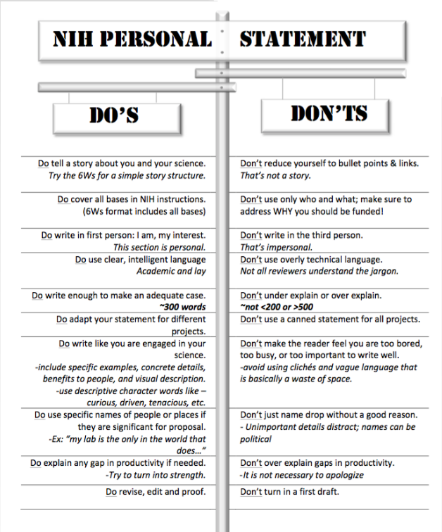
Personal Statement

Slide 8
Positions and Honors
List in chronological order the positions you have held relevant to this proposal, including your current position.
List relevant academic and professional achievements. Be sure to include
For students, post-docs, and junior faculty: scholarships, traineeships, fellowships, and/or development awards.
For clinicians: clinical licensures and specialty board certifications.

Slide 9
Contributions to Science
Briefly describe up to five of your most significant contributions to science.
Each contribution should be no longer than half a page including citations.
Each contribution should include
Historical Background that frames the scientific question
Central Findings
Influence of findings on the progress of science/application of those findings in health or technology
Your specific role in the work
Citation of up to four publications or research product relevant to the contribution.
Notes:
It’s about what you have Done

Slide 10
Contributions to Science
Tell your story using transitioning and signaling sentences.
My first contributions to science were in the field of …….where my early academic career work was focused on ….. As an undergraduate, my honors paper was published in the field of ….and my master’s thesis was ….Both research projects were funded by …..
After shifting my focus from clinical practice to public health, my doctoral academic work led to contributions to science related to understanding …..As a PhD student in …..my dissertation….My research revealed that …..
My most recent contributions to science…
My most significant contribution to science, however…
Notes:
It’s about what you have Done

Slide 11
Research Support
List ongoing and completed research projects from the past three years.
Note the overall goals of the projects.
If you do not have current or completed support, it is ok to list “None”.

Slide 12
Facilities and Resources
Justify your ability to conduct the proposed studies by showing you have the necessary resources.
Discuss how the scientific environment will contribute to the probability of success (institutional support, physical resources, collaborative arrangements, and intellectual rapport);
Describe facilities and resources germane to this project, both on and off campus.

Slide 13
Facilities and Resources
For Early Stage Investigators (ESI), also describe institutional investment in the success of the investigator.
Resources for classes, travel, or training
Collegial support, such as career enrichment programs, assistance and guidance in the supervision of trainees involved with the ESI’s project, and availability of organized peer groups
Logistical support, such as administrative management & oversight, best practices
Training
Financial support, such as protected time for research with salary support

Slide 14
Facilities and Resources
Laboratory
Animal
Clinical
Computer
Office
Other
TRI has a comprehensive UAMS Resources Database
http://triapps.uams.edu/resources/

Slide 15
PHS Human Subjects and Clinical Trials Information Form
Used to collect information on human subjects research, clinical research, and/or clinical trials.
Four sections
Section 1 - Basic Information
Section 2 - Study Population Characteristics (includes Inclusion Enrollment Report)
Section 3 - Protection and Monitoring Plans
Section 4 - Protocol Synopsis
Section 5 - Other Clinical Trial-related Attachments

Slide 16
PHS Human Subjects and Clinical Trials Information Form
Read your application instructions and your FOA.
The form is very detailed.
Ask for help!

